Slide 1
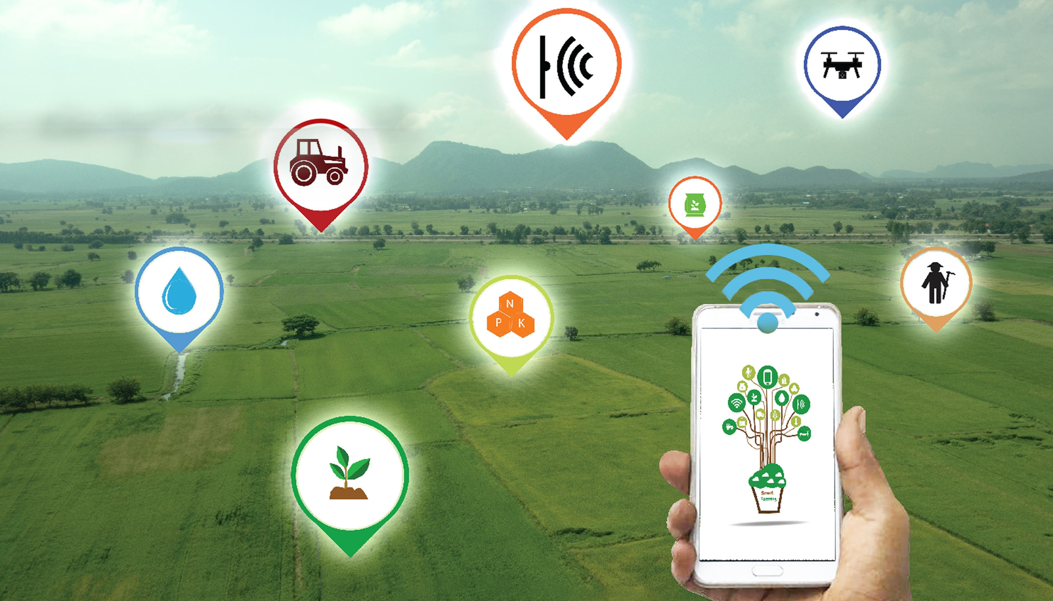
Smart Nkunganire System
Notes:
Today, we are proud to introduce to you the Smart Nkunganire System.

Slide 2
History of Nkunganire (SUBSIDY) in Rwanda
2008 – Launch of the Subsidy Program under the CIP ; administered by MINAGRI
2015 – The Subsidy program expands from 4 to 10 crops
2018 – Subsidy system reaches > 1,000,000 farmers and 1016 agro-dealers
2018 – Local government authorities join SNS platform: 30 Directors of Agriculture, 30 Districts Agronomists and 416 Sector Agronomists
2017 – RAB and BK Techouse sign the MOU guiding the development and Implementation of
Smart Nkunganire System
Notes:
SNS Objectives:
Create a digital database of all stakeholders involved in the agro-input Subsidy Program
Digitize the agro-input subsidies payments’ processes via a built-in capability to issue Instant Electronic Pay Slips
Bridge the communication gap between all stakeholders in the ecosystem
Improve stock management at all levels in the supply chain and give decision makers at all level real time visibility on Supply Vs Demand for agro-input
Promote Cashless transaction through any integrated financial institution
Promote Green Economy by significantly cutting down the use of paper
Reduce Fraud and Human Errors
Empower decision makers at all levels with real time analytics powered reports

Slide 3
SNS Progress
1
Integration with NIDA and LAIS platforms has been completed
1,233,944 farmers registered to date on SNS by dialing USSD code *774# through all existing telecommunication networks (MTN, AIRTEL/TIGO)
Stakeholders under the government of Rwanda Subsidy scheme registered their organizations through the SNS web platform (www.smartnkunginare.rw)
“Mobile Ordering Process Application” (MOPA) is functional
Phase 1 & II
Completed
2
Phase III
In Progress
Financial Inclusion and Market Linkages, for instance IKOFI e-wallet

Slide 4
SNS value Proposition (Agro-deALERS)
Farmers register for inputs using USSD short code
Requests approved by sector agronomist through SNS
Agro-dealers (AGDs) informed of all orders through MOPA
AGDs Places orders to suppliers using MOPA
All parties get approvals and conduct payment electronically
AGDs inventory automatically updated after farmer confirms
AGDs confirms farmer’s credentials with SNS ID and Phone/ fob
Upon delivery, AGDs inventory automatically updated

Slide 5
SNS value Proposition (farmers)
Farmers register for inputs using USSD short code
Farmer receives approval from sector agronomist
Farmer able to apply for loan using same system; farmer is approved for loan
Farmer goes to pick up inputs; uses ID + fob to purchase without cash
Farmer makes regular payments to agro-dealer, who is also bank agent
Farmer’s remaining loan is paid directly by buyer; farmer collects any leftover amount as cash
Farmer hands over harvest to buyer or agent using key fob to secure transaction
Farmer is matched with buyer for extra harvest

Slide 6
Become part of the solution
Transition to a green future
Create financial inclusion opportunities for farmers
Join us and help create the future of Rwandan agriculture

